Slide 1
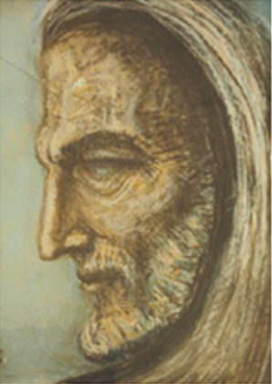

Artificial Intelligence (Machine Learning & Deep Learning)
NAVTCC & Strings Technologies
by Salman Ahmad

Slide 2
Outline Week 4 Day 4-5
Supervised machine learning
1
2
Regression and classification problems
Components of supervised machine learning
3
4
labeled data, hypothesis
cost function
5
6
optimizer

Slide 3
Supervised Machine Learning
A machine learning technique where the model learns from labeled data.
Each training example is a (input, output) pair.
The model is trained to predict the output given new inputs.
Supervised Learning Workflow
Collect labeled data (e.g., images + labels, texts + sentiments)
Train model to map inputs → outputs
Validate on unseen data
Test model performance
Deploy to make real-world predictions

Slide 4
Types of Supervised Learning
Classification
Predict categories or classes
Output is discrete
Examples:
Spam detection: spam / not spam
Disease diagnosis: flu / covid / healthy
Sentiment analysis: positive / negative / neutral

Slide 5
Types of Supervised Learning
Regression
Predict numerical values
Output is continuous
Examples:
House price prediction
Predicting blood sugar levels
Forecasting sales revenue

Slide 6
Popular Algorithms
Classification:
Logistic Regression
Decision Trees / Random Forest
Support Vector Machine (SVM)
K-Nearest Neighbors (KNN)
Naive Bayes
Neural Networks (for deeper classification tasks)
Regression:
Linear Regression
Ridge / Lasso Regression
Decision Trees
Support Vector Regression (SVR)
XGBoost
Deep Neural Networks

Slide 7
Popular Algorithms
Evaluation Metrics
Task Metrics
Classification Accuracy, Precision, Recall, F1-Score, AUC
Regression MSE, MAE, RMSE, R²

Slide 8
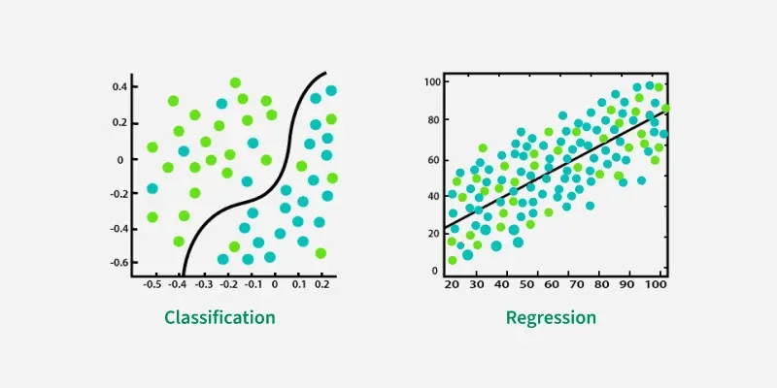
Classification Vs Regression

Slide 9


Classification
Dog
Cat

Slide 10
Regression
Year | Price
2021 | 1000
2022 | 1100
2023 | 1557
2024 | 2000
2025 | ?
2300

Slide 11
Components of Supervised ML
Labeled Data
The foundation of supervised learning.
Contains input-output pairs:
Inputs (X): Features (e.g., age, income, pixels)
Outputs (Y): Labels/targets (e.g., spam/not spam, price)
The model learns by comparing its predictions to these true labels.

Slide 12
Components of Supervised ML
Hypothesis Function
The model’s internal mapping from inputs to outputs.
Represented mathematically as:
y^ = h(x) (prediction)
For linear regression:
y^ = w1x1 + w2x2 + … + b

Slide 13
Components of Supervised ML
Cost/Loss Function
Measures the error between predictions and actual values.
Helps the model understand how wrong it is.
Cost functions help determine how well a machine learning model is learning from data
The aim of training a model is to minimize the cost function.
Examples:
Classification: BCE, CE
Regression: MSE, RMSE

Slide 14
Components of Supervised ML
Optimizer
Algorithm used to adjust model parameters (weights) to minimize the loss.
Moves the model toward better predictions using gradient descent or its variants.
Common Optimizers:
SGD (Stochastic Gradient Descent)
Adam
RMSprop

Slide 15

Univariate Linear Regression
A method to model the relationship between a dependent variable y and an independent variable x.
Goal: Find the best-fit line y = mx + b that minimizes the error.
Univariate means only one input feature x.

Slide 16



Univariate Linear Regression
Key Components
Hypothesis Function:
Cost Function (MSE):
Gradient Descent:
Iteratively update weights to minimize cost:

Slide 17
Let’s Code

Slide 18

Questions?
"He who asks a question is a fool for a minute; he who does not remains a fool forever." – Confucius

